Slide 1
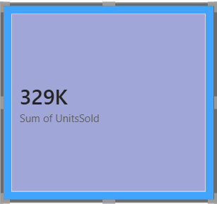
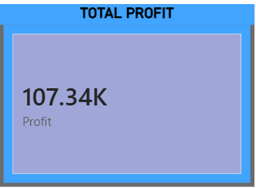
Data Analyst at ToyJoy

Slide 2
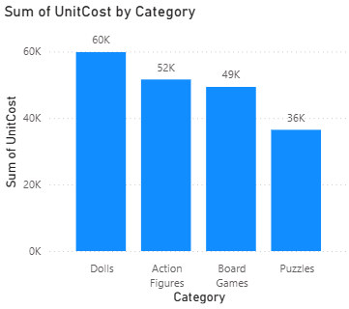
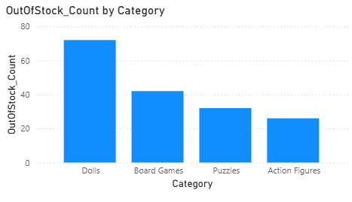
Number of units sold by each category
Number of out-of-stock units by each category

Slide 3
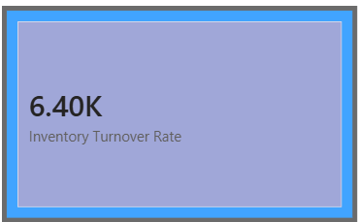
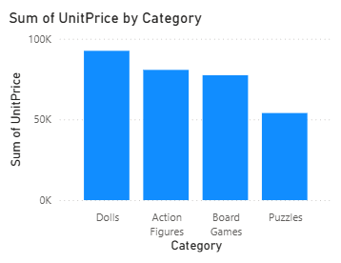
Inventory Turnover Rate
Sum of unit price by Category

Slide 4
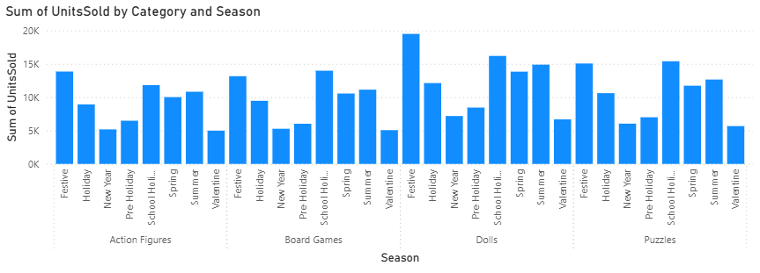
Festive Season = Peak Demand Driver
Inventory should be built 4–6 weeks before festive periods.
Focus marketing campaigns here.
School Holiday = Second Major Peak
Critical for Puzzles & Board Games.
Adjust reorder points upward before this season.
Low-Demand Seasons (Valentine’s Day, New Year)
Avoid overstocking.
Consider promotions to clear slow-moving inventory.
Dolls Show Highest Seasonal Volatility
Requires tighter forecasting & safety stock planning.

Slide 5
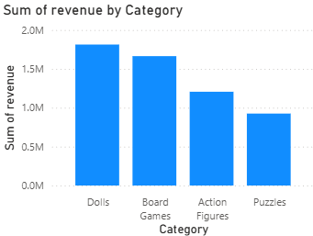
Total revenue
We have maximum revenue from doll

Slide 6
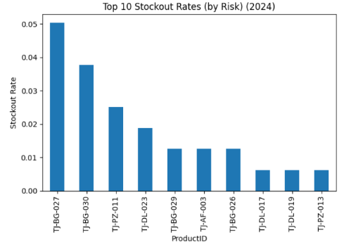
Here are the top 10 stocks that have the highest stockout rates.

Slide 7
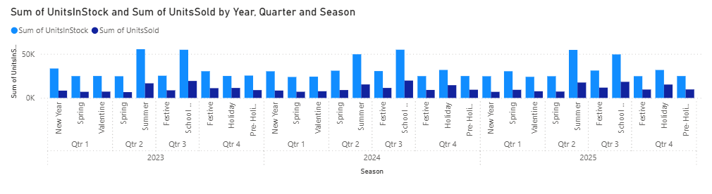
The analysis shows that inventory levels are often higher than actual sales, leading to excess capital being tied up. ToyJoy should reduce base inventory by 10–15% and implement dynamic reorder points based on demand and lead time. Seasonal peaks during Summer and Festive periods require advance stock planning, while post-peak replenishment should be tightened to prevent overstock.

Slide 8
Safety stock should be increased only for high-demand, high-stockout-risk products. A quarterly SKU review will help eliminate slow movers. These actions will improve turnover, reduce holding costs, and strengthen cash flow

